Slide 1
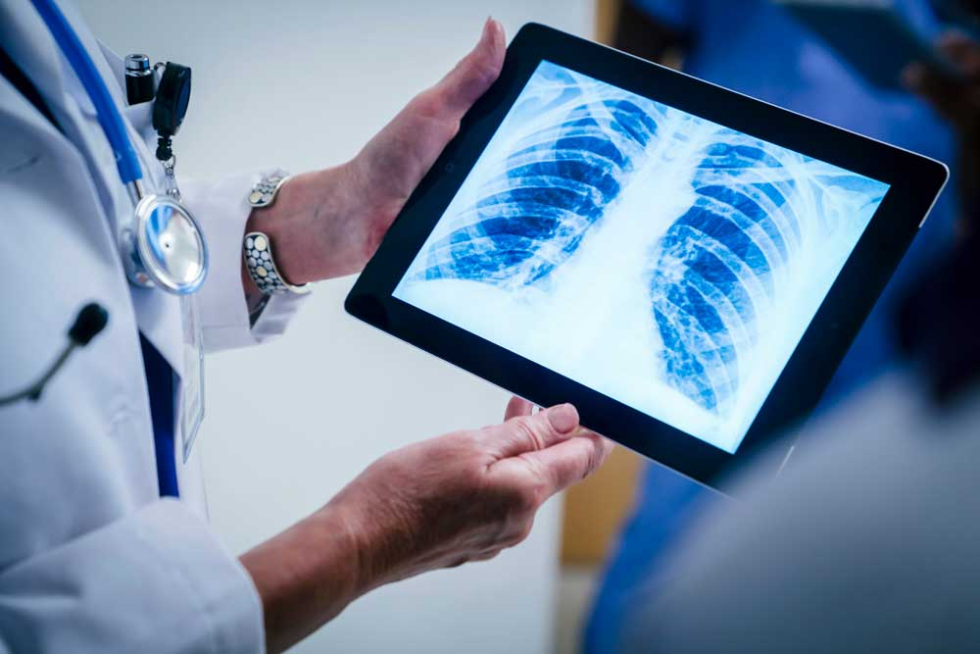
Chest X-Ray Image Classifications
KIRTI VARDHAN SINGH(210301120137)

Slide 2
AGENDA
Abstract
Introduction
Problem
Proposed Work
Result and comparison
Conclusion

Slide 3
Abstract
In this project, we develop a convolutional neural network (CNN) model for classifying chest X-rays as either normal or showing signs of pneumonia. The model was trained on a dataset of over 5,863 X-ray images, and achieved an accuracy of 89% on the test set. The architecture of the model consists of multiple convolutional layers, followed by max pooling and dense layers

Slide 4
Introduction
Pneumonia is a leading cause of death worldwide, particularly among children and the elderly. Early and accurate diagnosis is crucial for effective treatment and improving patient outcomes. X-ray imaging is one of the most widely used diagnostic tools for detecting pneumonia. However, interpreting X-ray images can be challenging, and misdiagnosis can have serious consequences. With the advent of deep learning, particularly Convolutional Neural Networks (CNNs), there has been a surge in the development of automated tools for diagnosing pneumonia from X-ray images. In this project, we developed a CNN model for the classification of X-ray images into two categories: normal and pneumonia. In this presentation, we will discuss the architecture of our CNN model, the dataset used for training and validation, and the results of our experiments. We will also discuss the potential impact of our model on clinical practice and its limitations

Slide 5
Problem
Early and accurate diagnosis is crucial for effective treatment and improving patient outcomes. X-ray imaging is one of the most widely used diagnostic tools for detecting pneumonia. However, interpreting X-ray images can be challenging, and misdiagnosis can have serious consequences. The problem is how automate tools for diagnosing pneumonia from X-ray images. And classifying X-ray images into two categories: normal and pneumonia..

Slide 6
Proposed Work
Develop a Convolutional Neural Network (CNN) model for classifying X-ray images into two categories: normal and pneumonia. The model will be trained on a large dataset of X-ray images to learn the features that distinguish normal lungs from lungs affected by pneumonia. The goal is to achieve high accuracy in classifying X-ray images and to create a reliable tool that can assist radiologists in their diagnoses. To develop the CNN model, We will fine-tune these model by retraining the last few layers on our dataset. We will also experiment with different architectures, such as varying the number of layers, filter sizes, and pooling operations, to improve the model performance. To evaluate the model's performance, we will use metrics such as accuracy, precision, recall, and F1-score. The ultimate goal of this project is to provide a reliable and accurate tool to assist radiologists in their diagnoses, especially in regions where there is a shortage of specialized medical personnel.

Slide 7
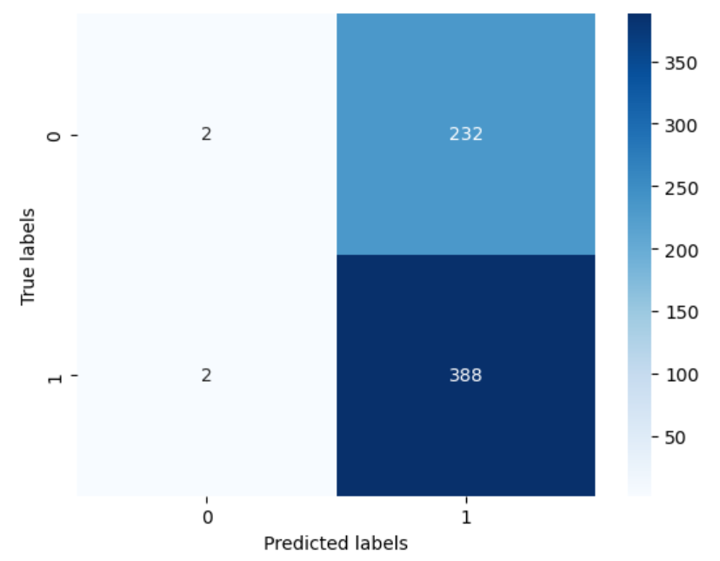
Result and Comparison
CONFUSION MATRIX

Slide 8
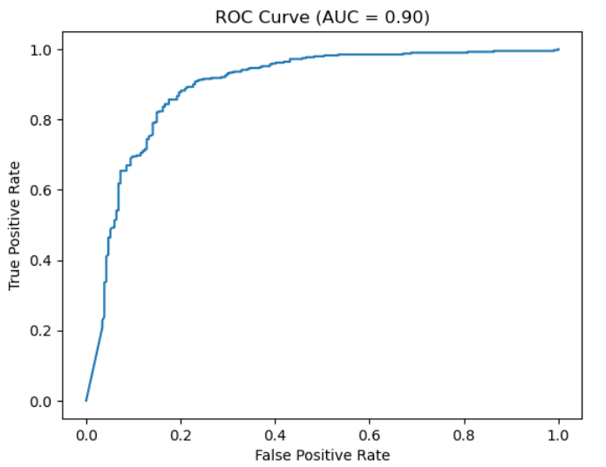
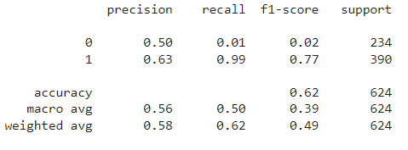
Result and Comparison
AUC curve
Classification report

Slide 9
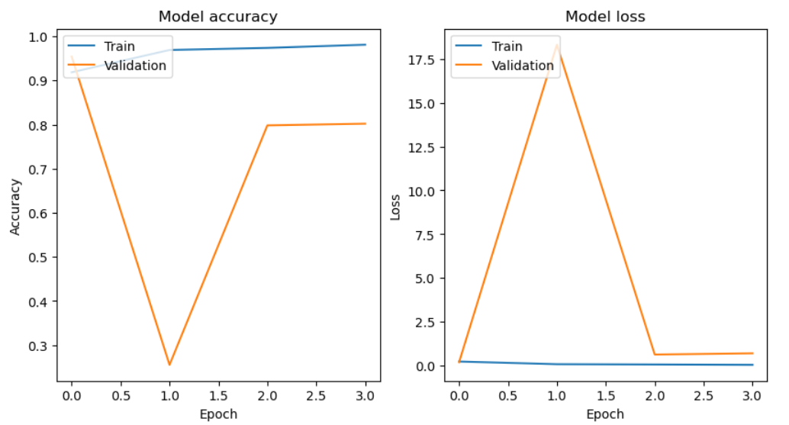
Graph between the training and validation accuracy and loss

Slide 10
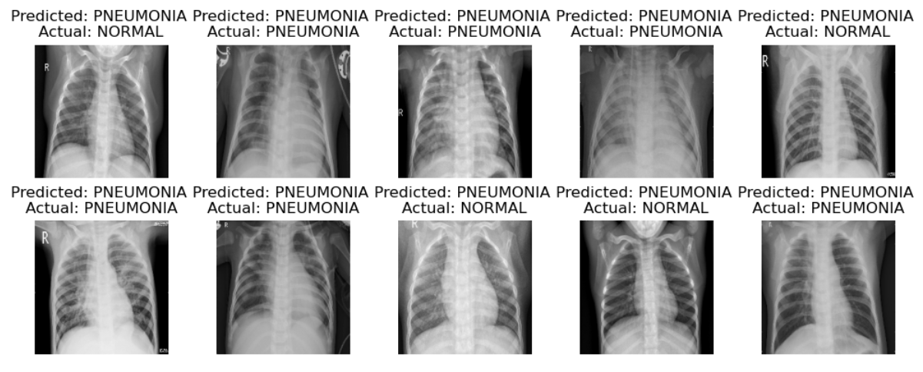
Result and Comparison

Slide 11
Conclusion
In conclusion, the proposed work aims to develop a CNN model for the classification of normal and pneumonia cases in X-ray images. The project has identified the need for accurate and efficient diagnosis of pneumonia, which can be achieved through the use of deep learning techniques. The model is expected to be trained and tested on a large dataset of X-ray images to ensure its effectiveness and reliability. If successful, this model could potentially be used in hospitals and clinics to assist radiologists and physicians in making accurate diagnoses, leading to improved patient outcomes and better management of pneumonia cases.

Slide 12
Thank you

